Slide 1
Report batch 20230315_MW

Slide 2
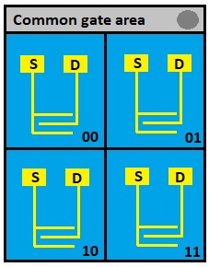

General features
Batch made up of 4 different material compositions
Every composition is used in 2 substrates, each one with 4 OFET with common gate
32 transistors in total, 8 for every composition
TMTES:PS as active material, with fixed 2:1 ratio
Channel features: L=25µm, W=2500µm, C=17.3·${10}^{−9}$F/${cm}^{2},$
$A_{pixel}={4.25·10}^{−3}{cm}^{2}$

Slide 3
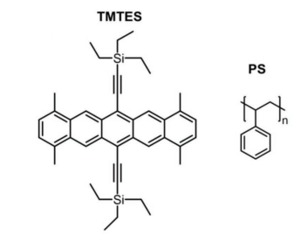
Compositions
TMTES:PS ratio is fixed at 2:1, but the molecular weight of PS (a polymer with variable chain length) is varied
Pristine: Sample5 and Sample6 No PS present
280K: Sample11 and Sample12
100K: Sample17 and Sample18
10K: Sample23 and Sample24
Tamayo A., Fratelli I., Ciavatti A., Martínez-Domingo C., Branchini P., Colantoni E., de Rosa S., Tortora L., Contillo A., Santiago R., Bromley S. T., Fraboni B., Mas-Torrent M., Basiricò L., X-ray Detectors With Ultrahigh Sensitivity Employing High Performance Transistors Based on a Fully Organic Small Molecule Semiconductor/Polymer Blend Active, 2022

Slide 4
X-rays measurements: Current normalization
Polynomial fit before irradiation

Slide 5
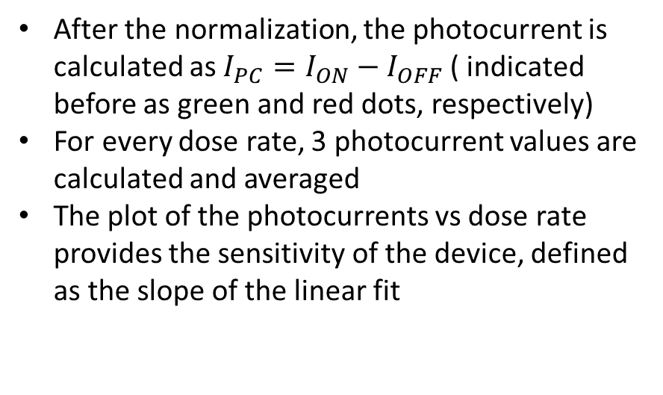
X-rays measurements: sensitivity calculation
After the normalization, the photocurrent is calculated as ${I_{PC}=I}_{ON}−I_{OFF}$ ( indicated before as green and red dots, respectively)
For every dose rate, 3 photocurrent values are calculated and averaged
The plot of the photocurrents vs dose rate provides the sensitivity of the device, defined as the slope of the linear fit

Slide 6
Pristine samples

Slide 7

Pristine samples
Transfer characteristics
Output characteristic (example)
:Working point ($V_{SG}=−5V, V_{SD}=−10V$)

Slide 8
Pristine: Current curves

Slide 9
Pristine: Photocurrent

Slide 10
Pristine: Transfer characteristic

Slide 11
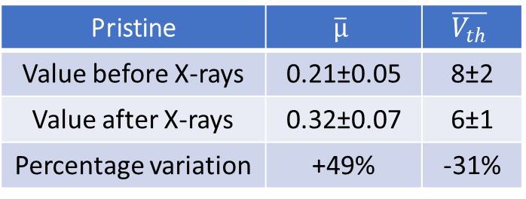
Pristine: Transfer before and after X-rays
Pristine | $$\overline{µ}$$ | $$\overline{V_{th}}$$
Value before X-rays | 0.21±0.05 | 8±2
Value after X-rays | 0.32±0.07 | 6±1
Percentage variation | +49% | -31%

Slide 12
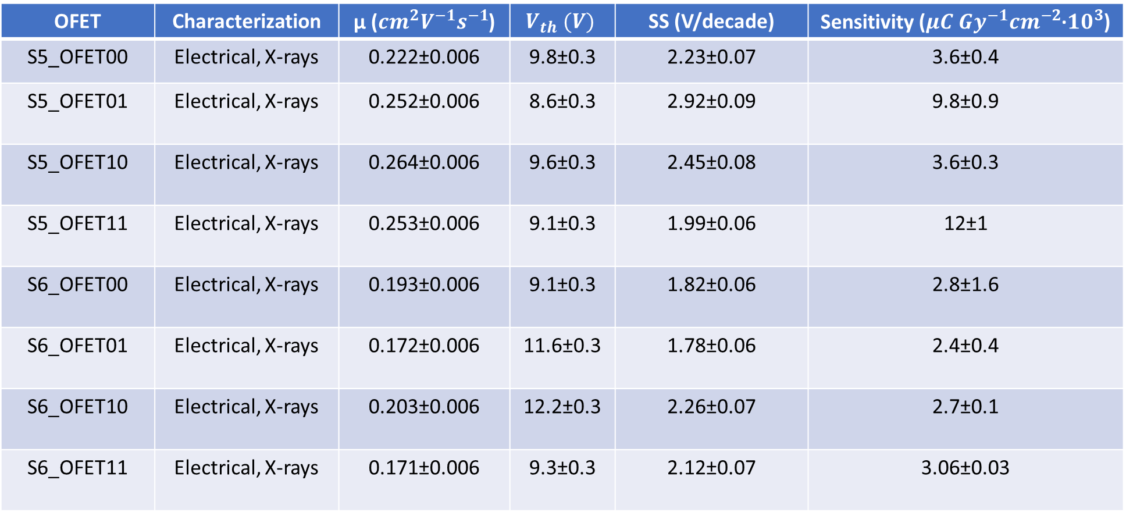
Summary table: pristine
OFET | Characterization | µ (${cm}^{2}V^{−1}s^{−1}$) | $$V_{th} (V)$$ | SS (V/decade) | Sensitivity (${{μC Gy}^{−1}cm}^{−2}$·${10}^{3}$)
S5_OFET00 | Electrical, X-rays | 0.222±0.006 | 9.8±0.3 | 2.23±0.07 | 3.6±0.4
S5_OFET01 | Electrical, X-rays | 0.252±0.006 | 8.6±0.3 | 2.92±0.09 | 9.8±0.9
S5_OFET10 | Electrical, X-rays | 0.264±0.006 | 9.6±0.3 | 2.45±0.08 | 3.6±0.3
S5_OFET11 | Electrical, X-rays | 0.253±0.006 | 9.1±0.3 | 1.99±0.06 | 12±1
S6_OFET00 | Electrical, X-rays | 0.193±0.006 | 9.1±0.3 | 1.82±0.06 | 2.8±1.6
S6_OFET01 | Electrical, X-rays | 0.172±0.006 | 11.6±0.3 | 1.78±0.06 | 2.4±0.4
S6_OFET10 | Electrical, X-rays | 0.203±0.006 | 12.2±0.3 | 2.26±0.07 | 2.7±0.1
S6_OFET11 | Electrical, X-rays | 0.171±0.006 | 9.3±0.3 | 2.12±0.07 | 3.06±0.03
$\overline{µ}=0.22\text{±}0.04, \overline{V_{th}}=\left(10\text{±}1\right) V, \overline{SS}=\left(2.2\text{±}0.4\right)V/decades$, $\overline{S}=(6.4±4.2)µC{Gy}^{−1}{cm}^{−2}{•10}^{3}$

Slide 13
280K samples

Slide 14

280K samples
Transfer characteristics
Output characteristic (example)
:Working point ($V_{SG}=−2.5V, V_{SD}=−10V$)

Slide 15
280K: Current curves

Slide 16
280K: Photocurrent

Slide 17
280K: Transfer characteristic

Slide 18
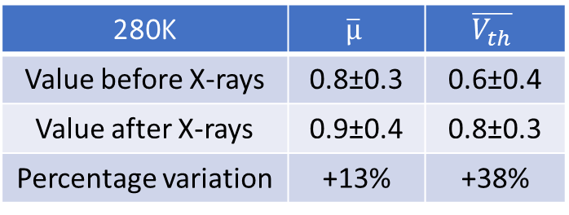
280K: Transfer before and after X-rays
280K | $$\overline{µ}$$ | $$\overline{V_{th}}$$
Value before X-rays | 0.8±0.3 | 0.6±0.4
Value after X-rays | 0.9±0.4 | 0.8±0.3
Percentage variation | +13% | +38%

Slide 19
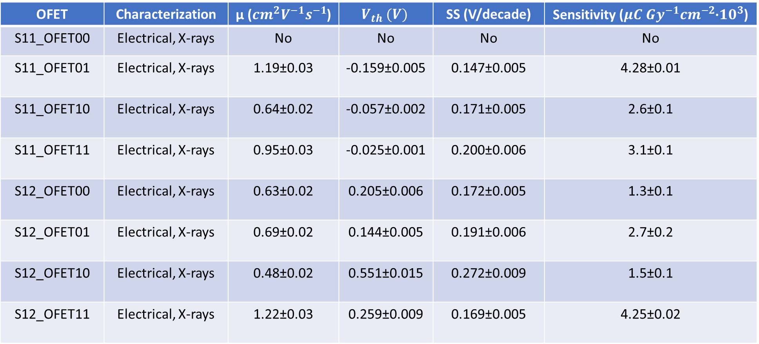
Summary table: 280K
OFET | Characterization | µ (${cm}^{2}V^{−1}s^{−1}$) | $$V_{th} (V)$$ | SS (V/decade) | Sensitivity (${{μC Gy}^{−1}cm}^{−2}$·${10}^{3}$)
S11_OFET00 | Electrical, X-rays | No | No | No | No
S11_OFET01 | Electrical, X-rays | 1.19±0.03 | -0.159±0.005 | 0.147±0.005 | 4.28±0.01
S11_OFET10 | Electrical, X-rays | 0.64±0.02 | -0.057±0.002 | 0.171±0.005 | 2.6±0.1
S11_OFET11 | Electrical, X-rays | 0.95±0.03 | -0.025±0.001 | 0.200±0.006 | 3.1±0.1
S12_OFET00 | Electrical, X-rays | 0.63±0.02 | 0.205±0.006 | 0.172±0.005 | 1.3±0.1
S12_OFET01 | Electrical, X-rays | 0.69±0.02 | 0.144±0.005 | 0.191±0.006 | 2.7±0.2
S12_OFET10 | Electrical, X-rays | 0.48±0.02 | 0.551±0.015 | 0.272±0.009 | 1.5±0.1
S12_OFET11 | Electrical, X-rays | 1.22±0.03 | 0.259±0.009 | 0.169±0.005 | 4.25±0.02
$\overline{µ}=(0.\text{8}\text{±}0.3){cm}^{2}V^{−1}s^{−1}, \overline{V_{th}}=\left(0.1\text{±}0.2\right) V, \overline{SS}=\left(0.\text{19}\text{±}0.04\right)V/decade$, $\overline{S}=(3.4±0.8)µC{Gy}^{−1}{cm}^{−2}{•10}^{3}$

Slide 20
100K samples

Slide 21

100K samples
Transfer characteristics
Output characteristic (example)
:Working point ($V_{SG}=−2.5V, V_{SD}=−10V$)

Slide 22
100K: Current curves

Slide 23
100K: Photocurrent

Slide 24
100K: Transfer characteristic

Slide 25
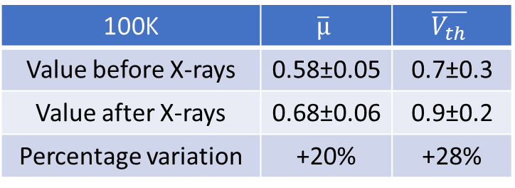
100K: Transfer before and after X-rays
100K | $$\overline{µ}$$ | $$\overline{V_{th}}$$
Value before X-rays | 0.58±0.05 | 0.7±0.3
Value after X-rays | 0.68±0.06 | 0.9±0.2
Percentage variation | +20% | +28%

Slide 26
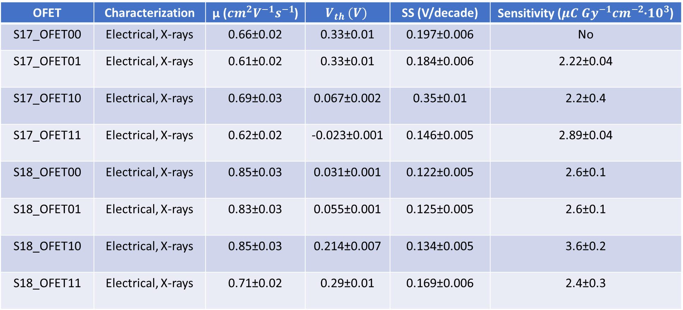
Summary table: 100K
OFET | Characterization | µ (${cm}^{2}V^{−1}s^{−1}$) | $$V_{th} (V)$$ | SS (V/decade) | Sensitivity (${{μC Gy}^{−1}cm}^{−2}$·${10}^{3}$)
S17_OFET00 | Electrical, X-rays | 0.66±0.02 | 0.33±0.01 | 0.197±0.006 | No
S17_OFET01 | Electrical, X-rays | 0.61±0.02 | 0.33±0.01 | 0.184±0.006 | 2.22±0.04
S17_OFET10 | Electrical, X-rays | 0.69±0.03 | 0.067±0.002 | 0.35±0.01 | 2.2±0.4
S17_OFET11 | Electrical, X-rays | 0.62±0.02 | -0.023±0.001 | 0.146±0.005 | 2.89±0.04
S18_OFET00 | Electrical, X-rays | 0.85±0.03 | 0.031±0.001 | 0.122±0.005 | 2.6±0.1
S18_OFET01 | Electrical, X-rays | 0.83±0.03 | 0.055±0.001 | 0.125±0.005 | 2.6±0.1
S18_OFET10 | Electrical, X-rays | 0.85±0.03 | 0.214±0.007 | 0.134±0.005 | 3.6±0.2
S18_OFET11 | Electrical, X-rays | 0.71±0.02 | 0.29±0.01 | 0.169±0.006 | 2.4±0.3
$\overline{µ}=\text{(0.7}\text{±}\text{0.1}){cm}^{2}V^{−1}s^{−1}, \overline{V_{th}}=\left(0.2±0.1\right) V, \overline{SS}=\left(0.18±0.07\right)V/decade$, $\overline{S}=(2.6±0.5)µC{Gy}^{−1}{cm}^{−2}{•10}^{3}$

Slide 27
10K samples

Slide 28
10K samples
Transfer characteristics
Output characteristic (example)
:Working point ($V_{SG}=−2.5V, V_{SD}=−10V$)

Slide 29
10K: Current curves

Slide 30
10K: Photocurrent

Slide 31
10K: Transfer characteristic

Slide 32
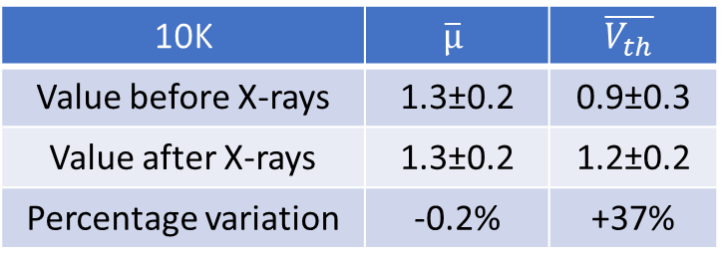
10K: Transfer before and after X-rays
10K | $$\overline{µ}$$ | $$\overline{V_{th}}$$
Value before X-rays | 1.3±0.2 | 0.9±0.3
Value after X-rays | 1.3±0.2 | 1.2±0.2
Percentage variation | -0.2% | +37%

Slide 33
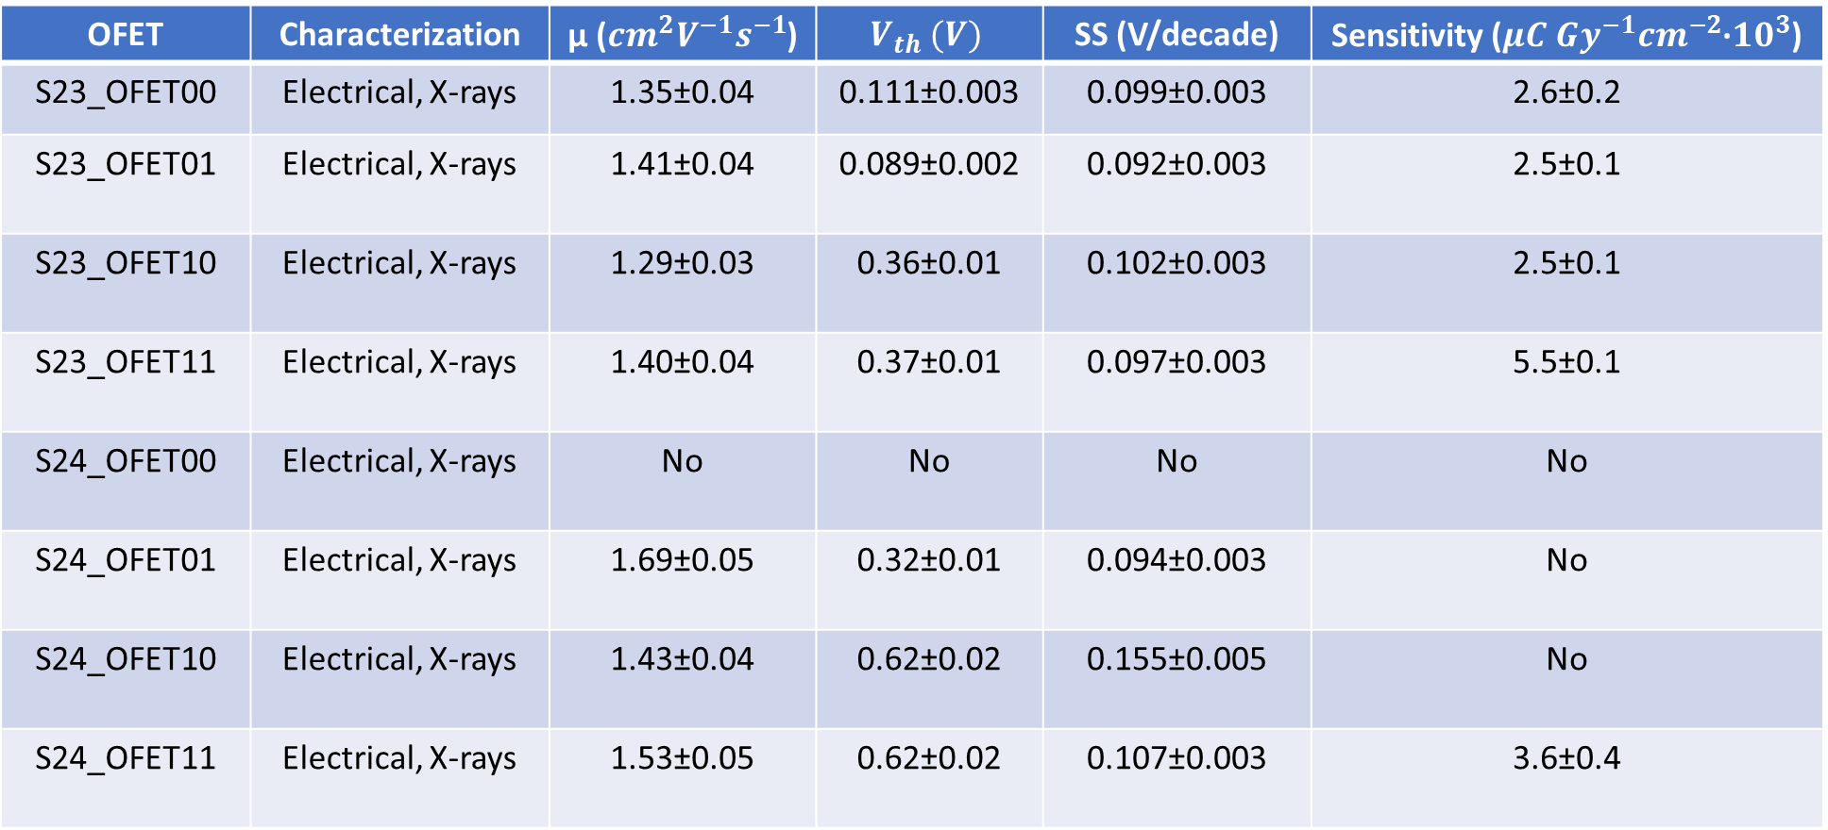
Summary table: 10K
OFET | Characterization | µ (${cm}^{2}V^{−1}s^{−1}$) | $$V_{th} (V)$$ | SS (V/decade) | Sensitivity (${{μC Gy}^{−1}cm}^{−2}$·${10}^{3}$)
S23_OFET00 | Electrical, X-rays | 1.35±0.04 | 0.111±0.003 | 0.099±0.003 | 2.6±0.2
S23_OFET01 | Electrical, X-rays | 1.41±0.04 | 0.089±0.002 | 0.092±0.003 | 2.5±0.1
S23_OFET10 | Electrical, X-rays | 1.29±0.03 | 0.36±0.01 | 0.102±0.003 | 2.5±0.1
S23_OFET11 | Electrical, X-rays | 1.40±0.04 | 0.37±0.01 | 0.097±0.003 | 5.5±0.1
S24_OFET00 | Electrical, X-rays | No | No | No | No
S24_OFET01 | Electrical, X-rays | 1.69±0.05 | 0.32±0.01 | 0.094±0.003 | No
S24_OFET10 | Electrical, X-rays | 1.43±0.04 | 0.62±0.02 | 0.155±0.005 | No
S24_OFET11 | Electrical, X-rays | 1.53±0.05 | 0.62±0.02 | 0.107±0.003 | 3.6±0.4
$\overline{µ}=\text{(1.4}\text{±}\text{0.1}){cm}^{2}V^{−1}s^{−1}, \overline{V_{th}}=\left(0.4±0.2\right) V, \overline{SS}=\left(0.11±0.02\right)V/decade$, $\overline{S}=(3.4±1.4)µC{Gy}^{−1}{cm}^{−2}{•10}^{3}$

Slide 34
Composition comparisons

Slide 35
Transfer characteristic
The presence of PS strongly reduces the hysteresis
The subthreshold swing is lower in PS samples by one order of magnitude
The presence of PS also improves the mobility and lowers the threshold voltage (next graphs)

Slide 36
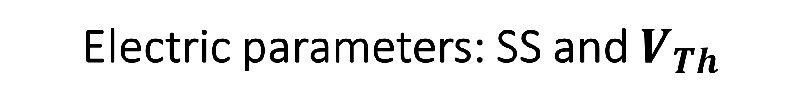
Electric parameters: SS and $V_{Th}$

Slide 37
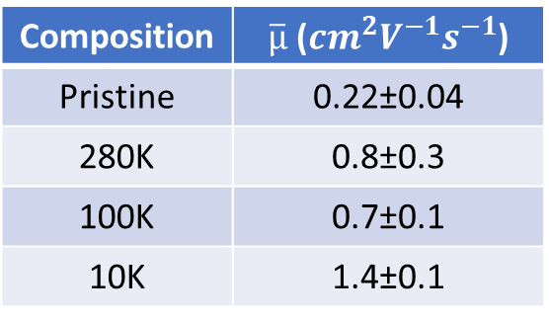
Electric parameters: mobility
Composition | $\overline{µ}$ (${cm}^{2}V^{−1}s^{−1}$)
Pristine | 0.22±0.04
280K | 0.8±0.3
100K | 0.7±0.1
10K | 1.4±0.1

Slide 38
X-rays detection: currents in time
In pristine samples, the current decreases due to bias stress (expected effect)
In PS samples, this effect is hindered by trap states passivation, but the origin of the current growth is not clear!

Slide 39
X-rays detection: normalized currents
Higher stability in response for PS samples
Less noise in presence of PS

Slide 40
X-rays detection: sensitivities
Statistic plot (left): boxes represent 25%-75% values, the vertical line connects minimum and maximum values for every composition
Graph on the right: mean sensitivity and standard deviation for every composition
No clear effect of PS molecular weight on performances!

Slide 41
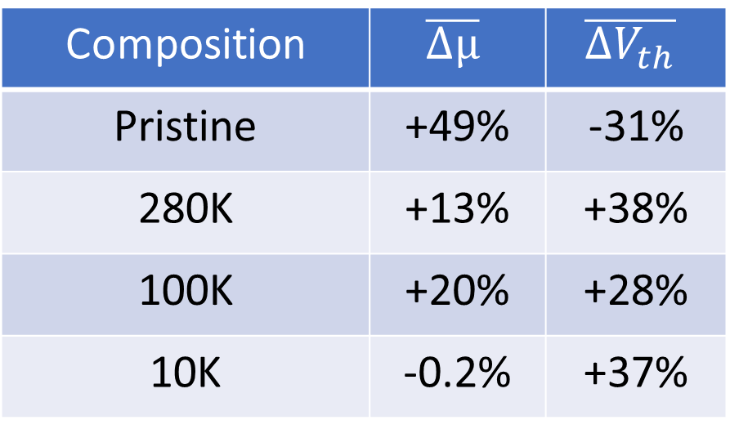
Resume on electical parameters variation after X-rays irradiation
Composition | $$\overline{Δµ}$$ | $$\overline{{ΔV}_{th}}$$
Pristine | +49% | -31%
280K | +13% | +38%
100K | +20% | +28%
10K | -0.2% | +37%

Slide 42
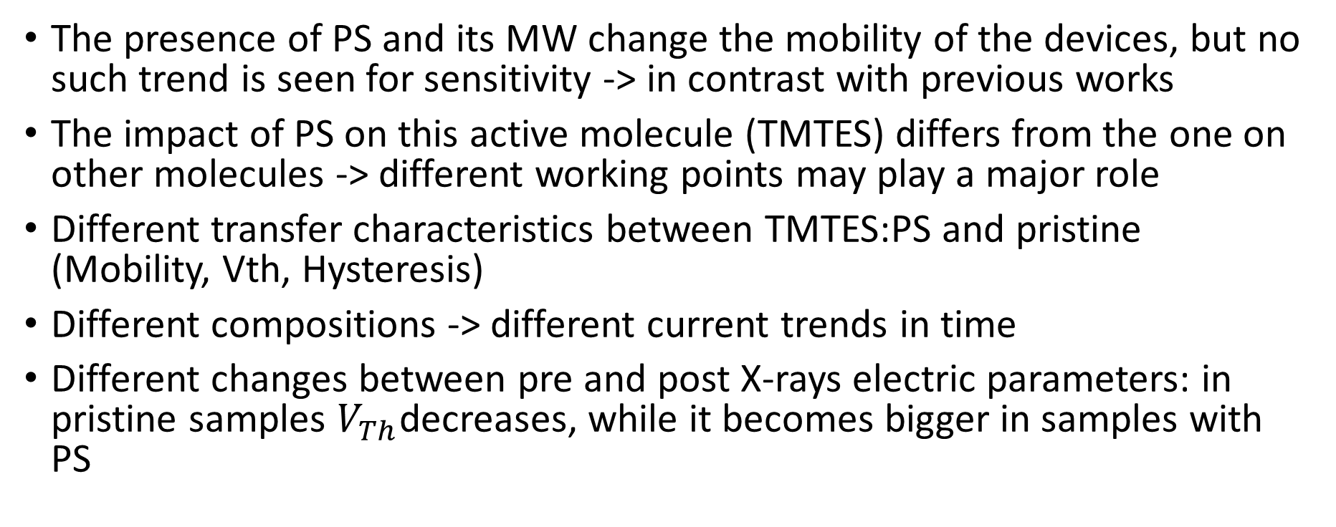
Conclusions
The presence of PS and its MW change the mobility of the devices, but no such trend is seen for sensitivity -> in contrast with previous works
The impact of PS on this active molecule (TMTES) differs from the one on other molecules -> different working points may play a major role
Different transfer characteristics between TMTES:PS and pristine (Mobility, Vth, Hysteresis)
Different compositions -> different current trends in time
Different changes between pre and post X-rays electric parameters: in pristine samples $V_{Th}$decreases, while it becomes bigger in samples with PS

